Slide 1


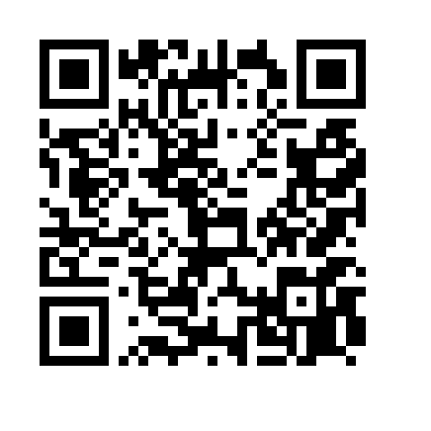

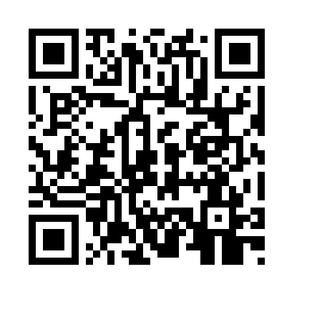
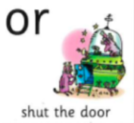
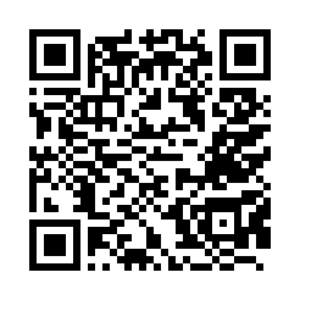
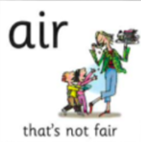
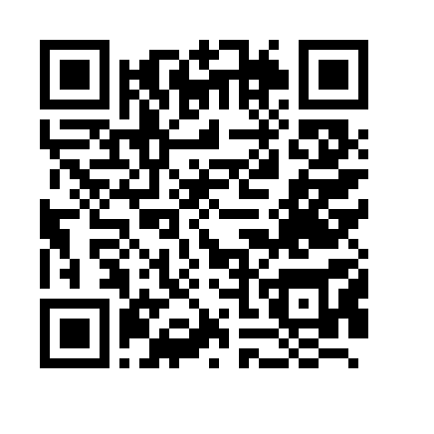

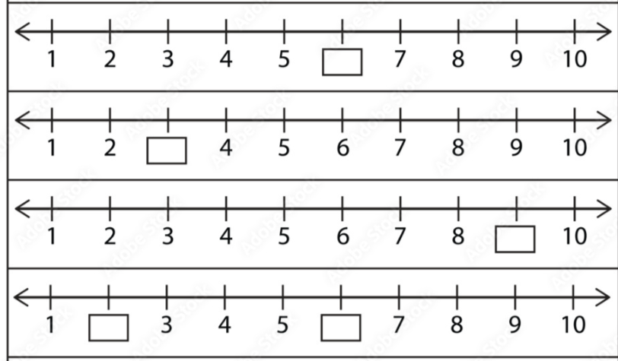
Homework Tasks
1.10.26
Class 3 and 4
Teacher: Miss Brown and Miss Cunnane
We have been focusing on these sounds; please support your child to practice and reinforce these sounds.
Can you read these words? Remember look for the special friend, Fred talk, read the word.
door star start fair chair
zoo hair sort short far
Weekly spellings
low
blow
snow
flow
throw
In maths, we have been completing number lines.

Slide 2

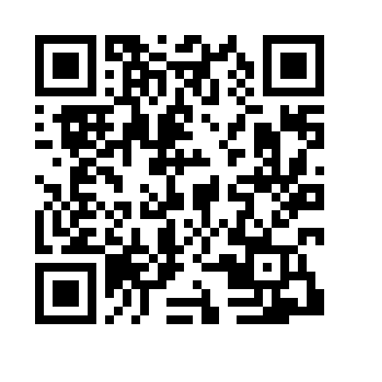

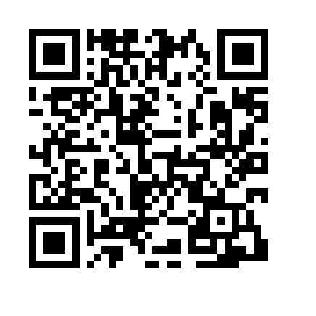
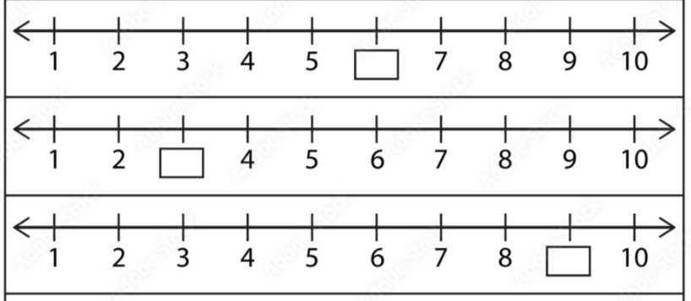
Homework Tasks
1.10.26
Class 3 and 4
Teacher: Miss Brown and Miss Cunnane
We have been focusing on these sounds; please support your child to practice and reinforce these sounds.
Can you read these words? Remember look for the special friend, Fred talk, read the word.
look took good book wood
throw low crow bowl day
Weekly spellings
low
blow
snow
brown
push
In maths, we have been completing number lines.

Slide 3

Homework Tasks
1.10.26
Class 3 and 4
Teacher: Miss Brown and Miss Cunnane
We have been focusing on these sounds; please support your child to practice and reinforce these sounds.
Can you read these words? Remember look for the special friend, Fred talk, read the word.
look took good book wood
throw low crow bowl day
Weekly spellings
low
blow
snow
brown
push
In maths, we have been completing number lines.

