Slide 1


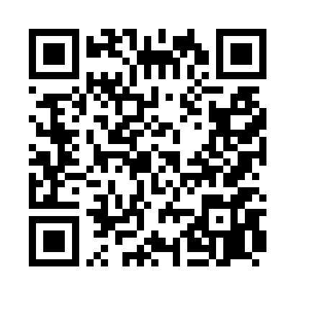
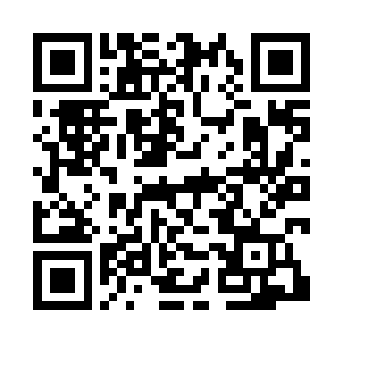
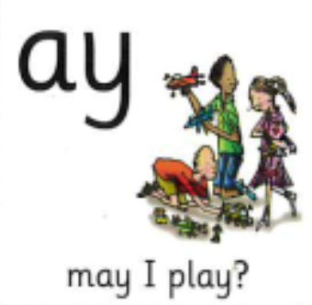

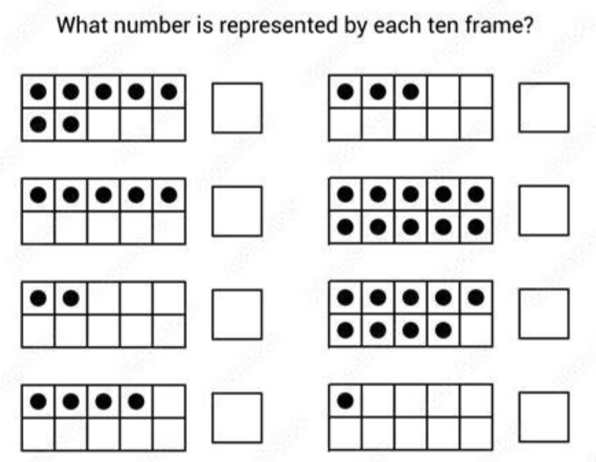
Homework Tasks
10.9.26
Class 3 and 4
Teacher: Miss Brown and Miss Cunnane
We have been focusing on these sounds; please support your child to practice and reinforce these sounds.
Can you read these words? Remember look for the special friend, Fred talk, read the word.
free feet meet play seed
green the push day she
Weekly spellings
been
see
sleep
week
bee
In maths, we have been looking at representing numbers to 10.

