Slide 1

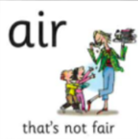
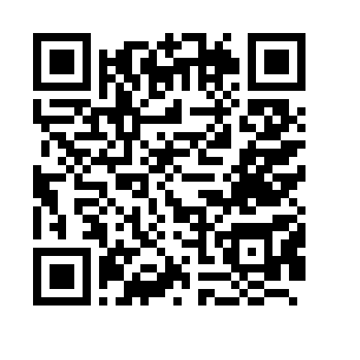

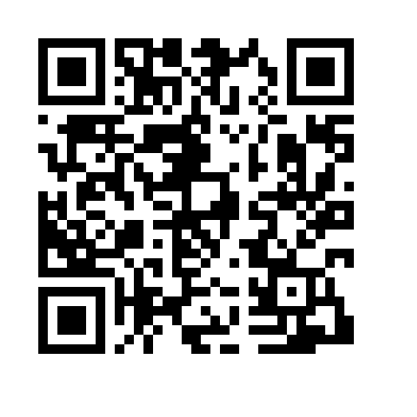

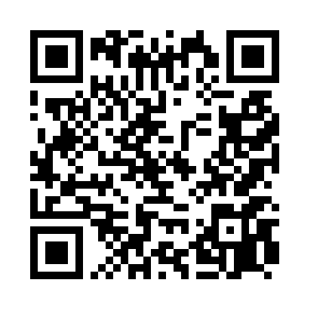
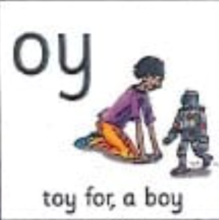
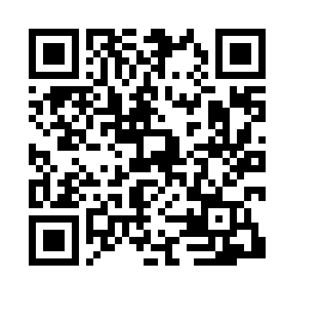

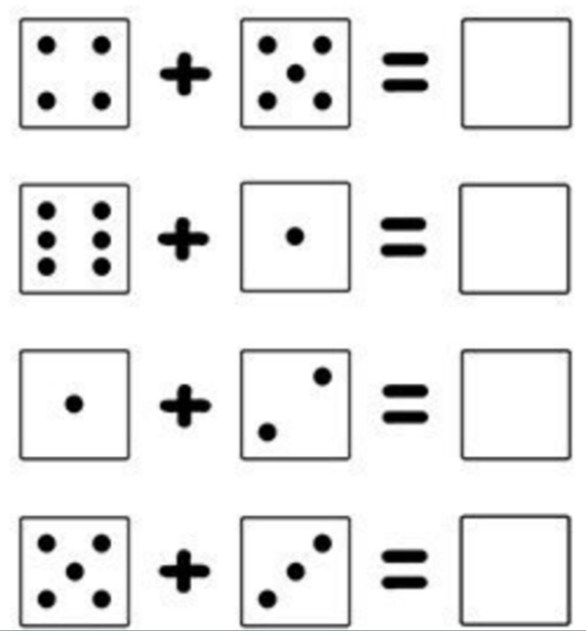
Homework Tasks
15.10.26
Class 3 and 4
Teacher: Miss Brown and Miss Cunnane
We have been focusing on these sounds; please support your child to practice and reinforce these sounds.
Can you read these words? Remember look for the special friend, Fred talk, read the word.
boy toy enjoy snow play
week night throw stand tray
Weekly spellings
look
took
book
hook
stood
In maths, we have been adding.

Slide 2

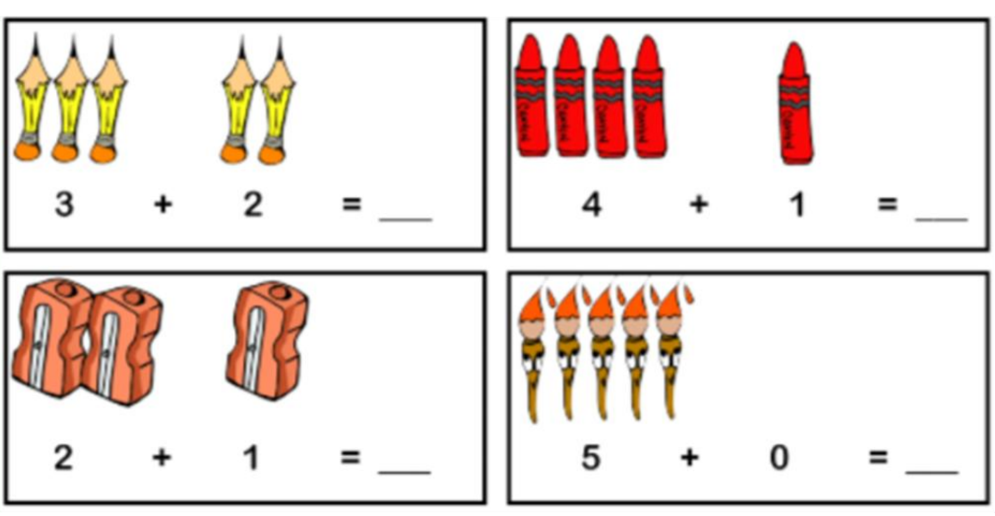
Homework Tasks
15.10.26
Class 3 and 4
Teacher: Miss Brown and Miss Cunnane
We have been focusing on these sounds; please support your child to practice and reinforce these sounds.
Can you read these words? Remember look for the special friend, Fred talk, read the word.
boy toy enjoy snow star
car blow see week day
Weekly spellings
think
link
shed
shed
was
In maths, we have been adding.

