Slide 1


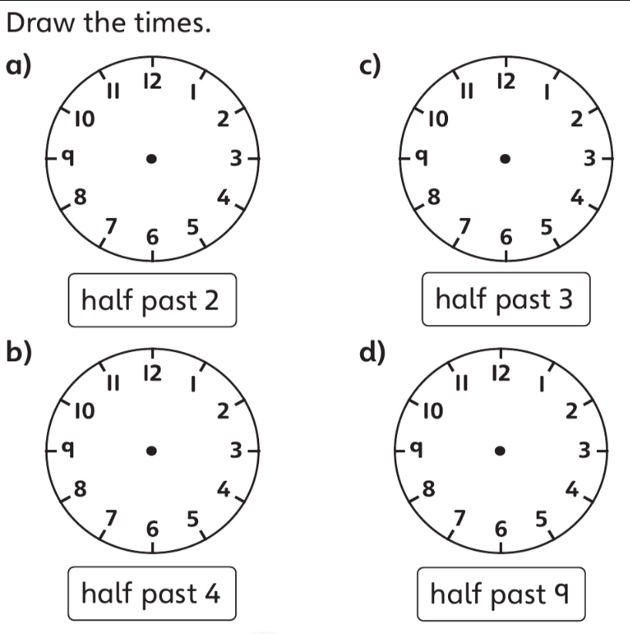
Homework Tasks
9.7.26
Class 3 and 4
Teacher: Miss Brown and Miss Cunnane
This week we have been learning about verbs. Verbs are action words—they tell us what someone or something is doing. Read each sentence carefully. Look at the two words. Choose the verb that makes the sentence correct and write it in the blank space.
The dog _____________ the cat up a tree. (read / chased)
The bird ____________ away. (flew / drove)
Kuba ___________ a chocolate ice cream. (wrote / ate)
I _____________ a movie. (listened / watched)
Jenny _____________ a book. (ate / read)
Can you read these words? Remember look for the special friend, Fred talk, read the word.
running chasing loudest biggest talked
carried stronger auntie nephew all
Weekly spellings
house
friend
said
because
when
In maths we have been looking at time.

Slide 2
Homework Tasks
9.7.26
Class 3 and 4
Teacher: Miss Brown and Miss Cunnane
This week we have been learning about verbs. Verbs are action words—they tell us what someone or something is doing. Read each sentence carefully. Look at the two words. Choose the verb that makes the sentence correct and write it in the blank space.
The dog _____________ the cat up a tree. (read / chased)
The bird ____________ away. (flew / drove)
Kuba ___________ a chocolate ice cream. (wrote / ate)
I _____________ a movie. (listened / watched)
Jenny _____________ a book. (ate / read)
Can you read these words? Remember look for the special friend, Fred talk, read the word.
when went where were who all
ball fall tall call today
Weekly spellings
hurt
curl
burn
church
burst
In maths we have been looking at time.

