Slide 1

Geography
KS2 knowledge

Slide 2
By the end of KS2, children should be able to recall the place and locational knowledge. The knowledge is built on and recapped each year to ensure children are secure.

Slide 3
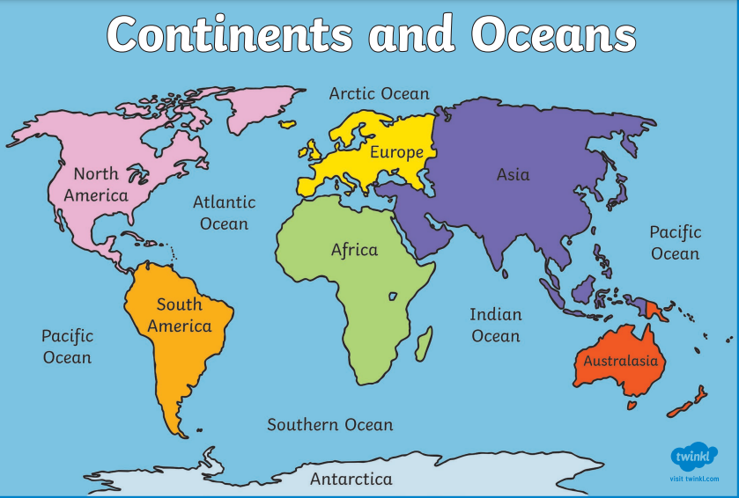
Key Stage 1
There are 5 oceans and 7 continents.
Can you name the 5 oceans?
Can you name the 7 continents?
https://www.youtube.com/watch?v=K6DSMZ8b3LE
https://www.youtube.com/watch?v=X6BE4VcYngQ

Slide 4
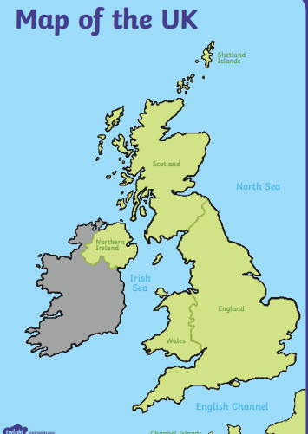
Key Stage 1
There are 4 countries in the United Kingdom
England
Scotland
Northern Ireland
Wales.
The capital cities are;
London
Edinburgh
Belfast
Cardiff
UK capital cities song
Edinburgh
Belfast
London
Cardiff

Slide 5
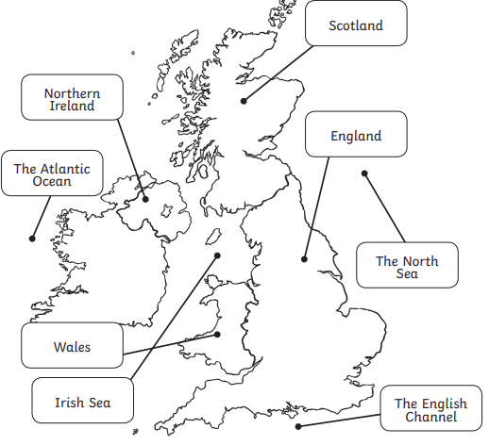
Key Stage 1
There are four seas surrounding the United Kingdom.
The North Sea
The English Channel
Irish Sea
The Atlantic Ocean.

Slide 6
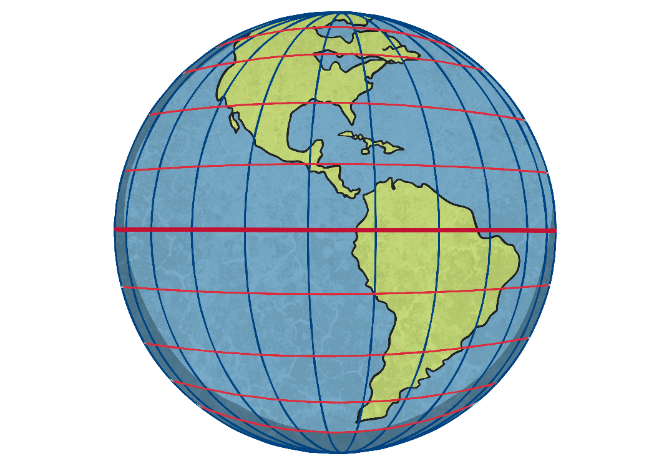
Latitude and Longitude
Invisible lines of latitude and longitude form a grid over the Earth.
These lines help to create a co-ordinate to locate a place accurately.
Line of Longitude
Line of Latitude

Slide 7
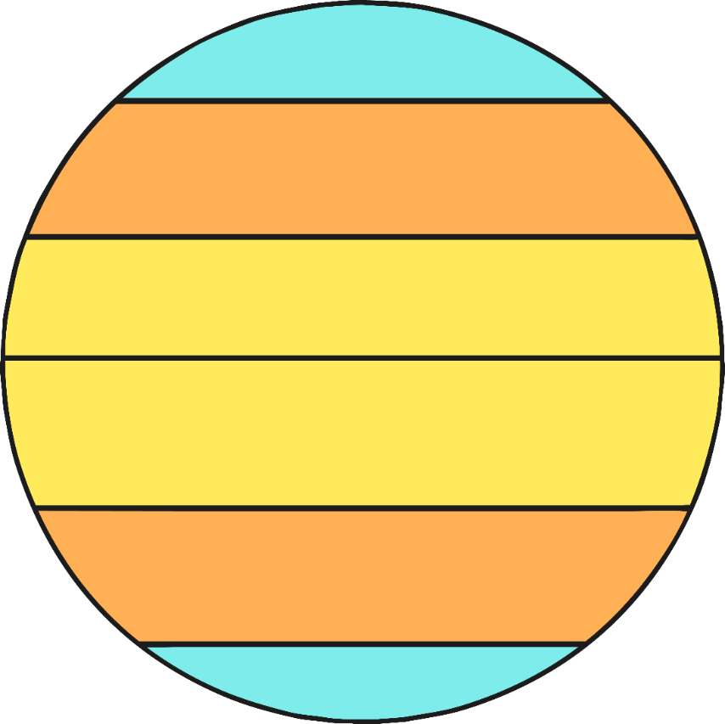
The Arctic Circle lies at 66.5 degrees north
whilst the Antarctic Circle likes at 66.5 degrees south.
The areas in blue and orange are those which have 4 distinct seasons.
Arctic Circle
The tropic of Cancer lies at 23.5 degrees north and the tropic of Capricorn lies at 23.5 degrees south of the Equator.
The area of the Earth which lies between both
of these lines is called the tropics.
tropic of Cancer
Equator
tropic of Capricorn
Antarctic Circle

Slide 8
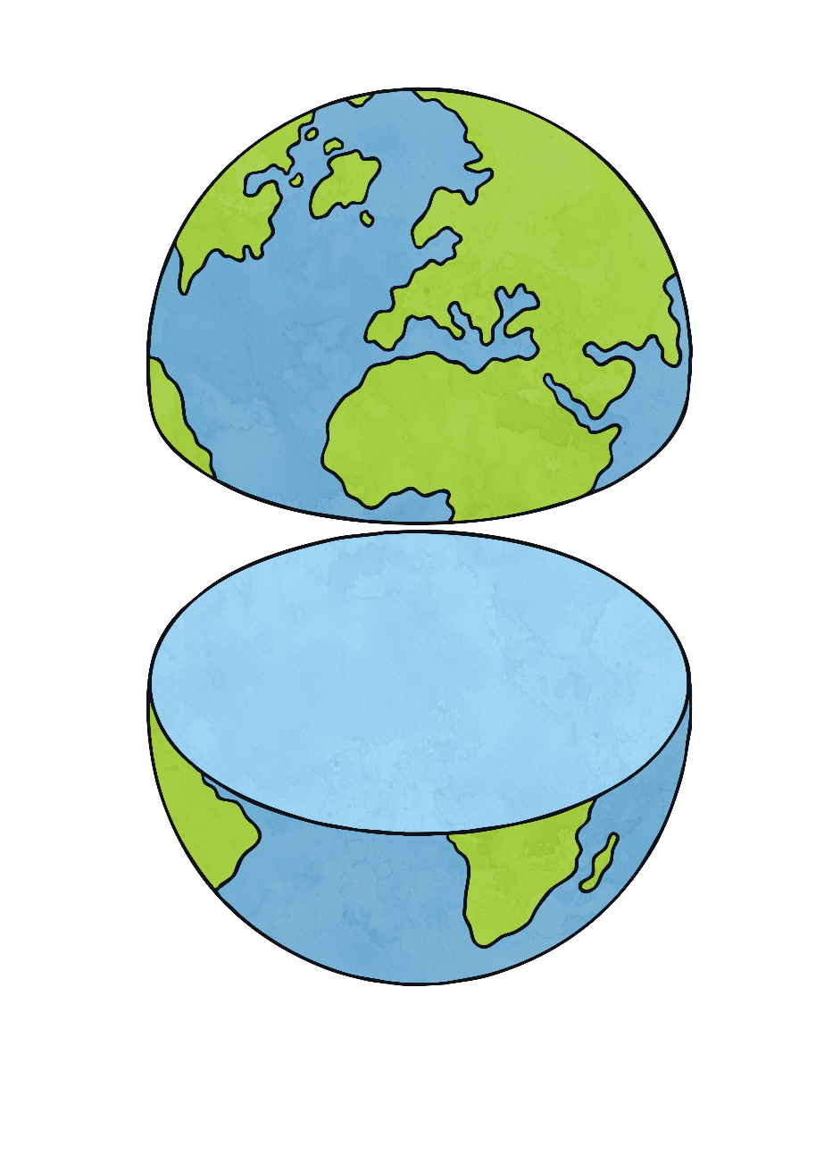
North Pole
  The Northern Hemisphere is anywhere north of the Equator whilst the Southern Hemisphere is anywhere south of the Equator.
Northern Hemisphere
Equator
Southern Hemisphere
South Pole

Slide 9
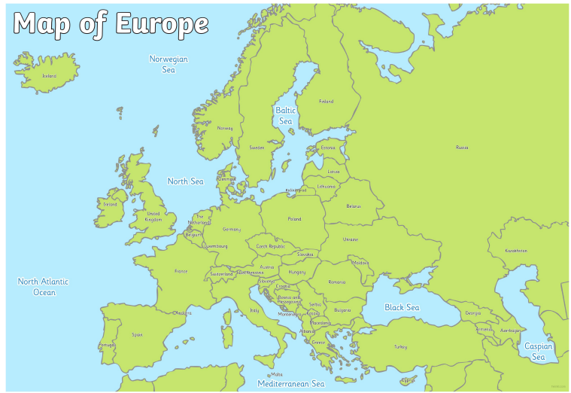
Russia
This is a map of Europe.
Spain

Slide 10
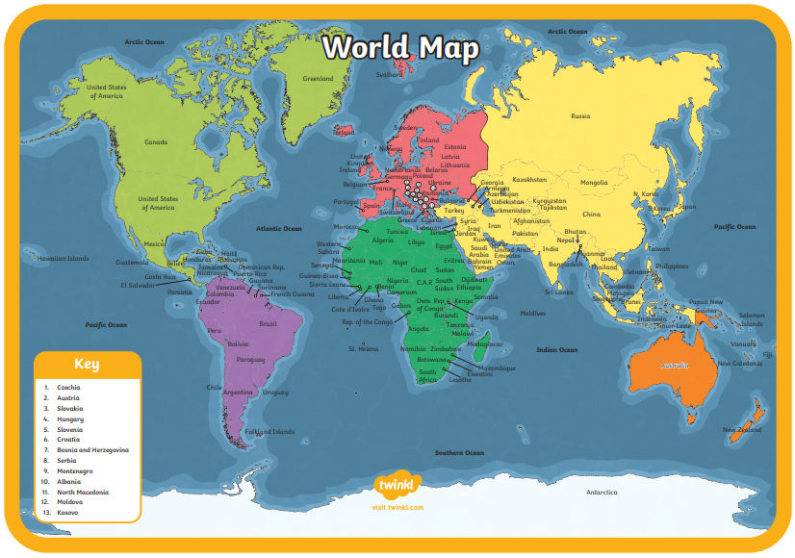
Russia
North America
South America
Brazil
Japan
Australia

Slide 11
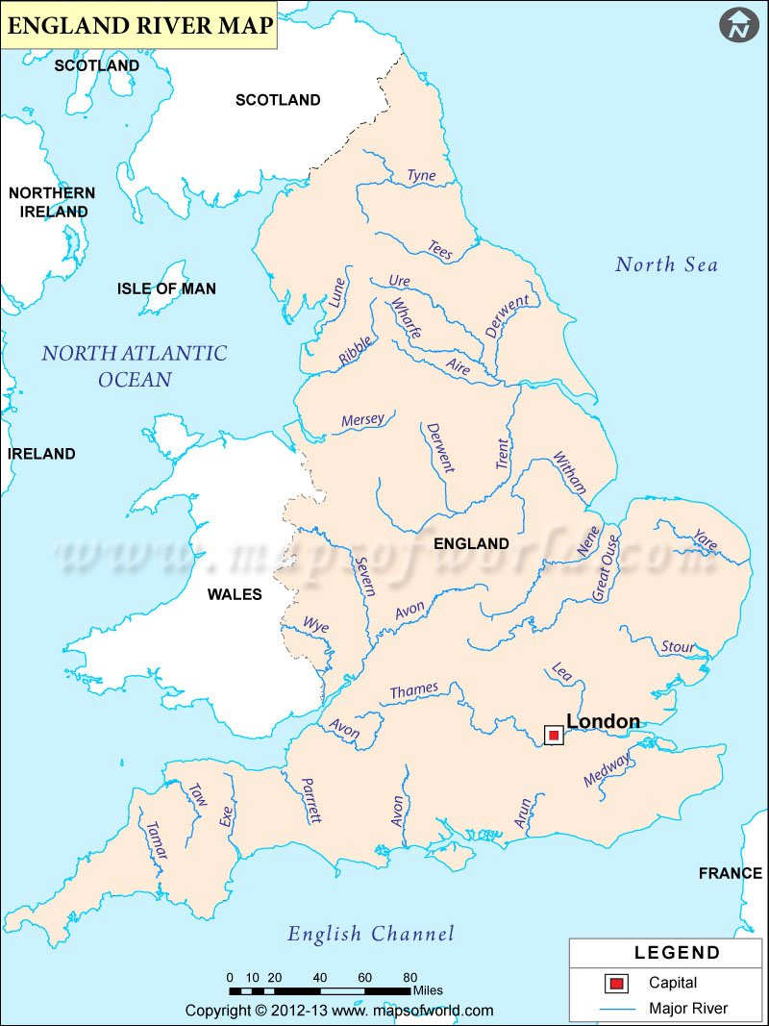
This map shows rivers in England.
Can you locate the rivers below?
Mersey
Thames
Trent
Severn
The River Severn is the longest - at 220 miles and the River Thames slightly shorter at 215 miles long.

Slide 12
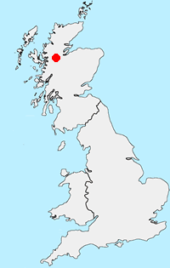
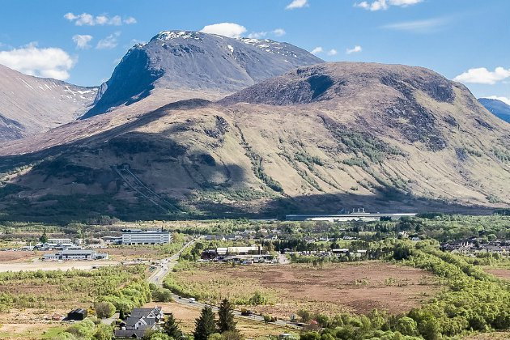
Ben Nevis is the highest point of the UK

