Slide 1

Geography
KS1 knowledge

Slide 2
By the end of KS1, children should be able to recall the place and locational knowledge. The knowledge is built on and recapped each year to ensure children are secure.

Slide 3
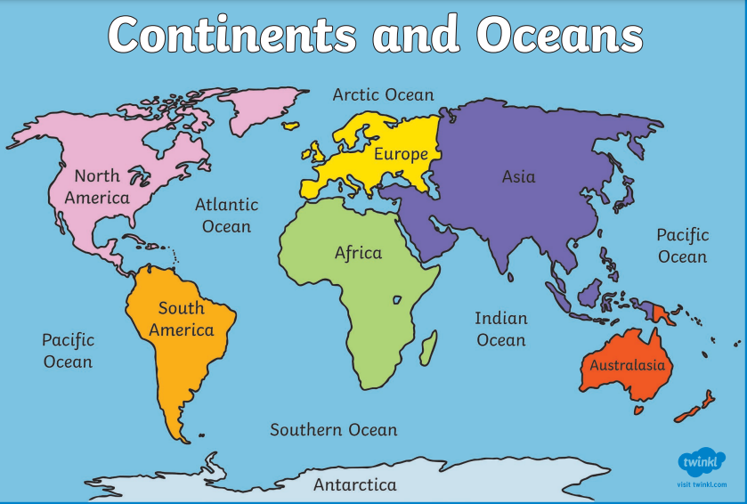
Year 2
There are 5 oceans and 7 continents.
Can you name the 5 oceans?
Can you name the 7 continents?
https://www.youtube.com/watch?v=K6DSMZ8b3LE
https://www.youtube.com/watch?v=X6BE4VcYngQ

Slide 4
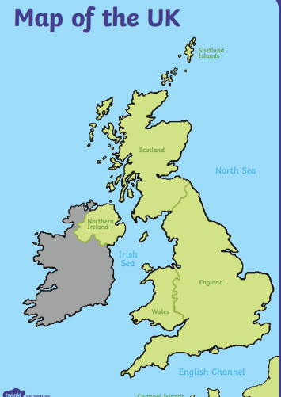
Year 2
There are 4 countries in the United Kingdom
England
Scotland
Northern Ireland
Wales.
The capital cities are;
London
Edinburgh
Belfast
Cardiff
https://www.youtube.com/watch?v=RvDIZoQLgIE
Edinburgh
Belfast
London
Cardiff

Slide 5
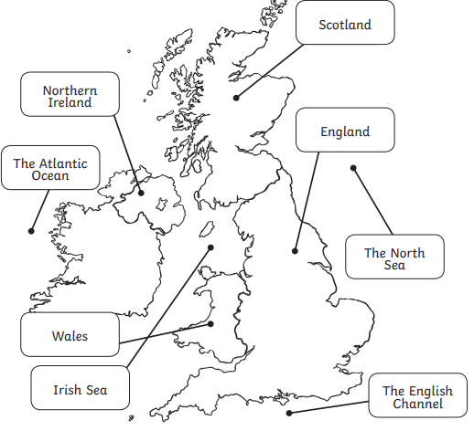
Year 2
There are four seas surrounding the United Kingdom.
The North Sea
The English Channel
Irish Sea
The Atlantic Ocean.

